Slide 1

Team Nine - Real LeJOS
System Design Project 2013/14
Ross, Daniel, Scott, Shova, Marijonas, Asteris, Peter, Dimitar, Rumyana.
Notes:
Hello, my name is Peter and I’m here to talk to you about our Team – “Real LeJOS”. And that’s “Real” pronounced like the football club, not like the data type!

Slide 2
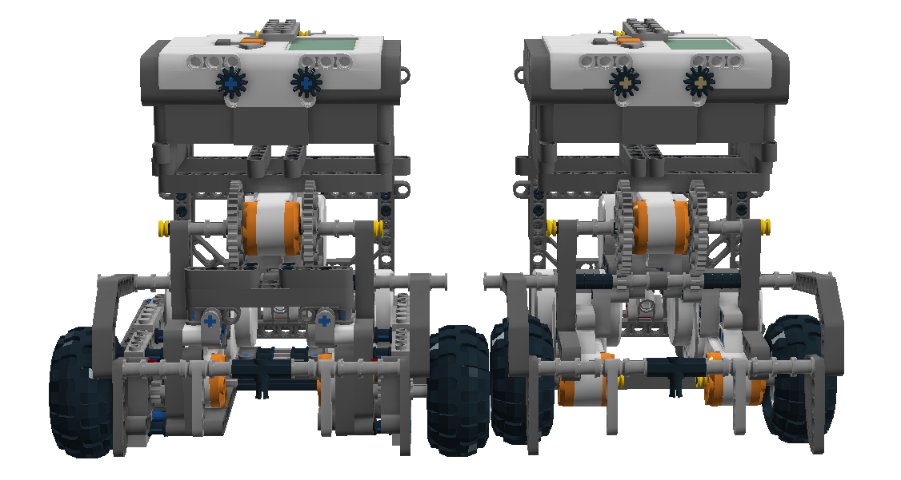
Topics
Team Management
Vision Subsystem
Robot Design
Strategy Subsystem
Notes:
Today we are going to introduce you to our team’s philosophy, and overview a few sections of our design that we feel really stand out from the crowd.

Slide 3

Team Management
Keep it simple and reliable.
Agile Development Process
Focus on reliability
Everybody contributes
Communication is key
Flexible task assignment
Notes:
If our team were to have a motto, it would be this: Keep it simple and reliable.
Agile Development Process: The team followed an agile method of design; Keeping it as simple as possible, while adding new features on a regular basis and testing consistently.

Slide 4
Team Management
Keep it simple and reliable.
Agile Development Process
Focus on reliability
Everybody contributes
Communication is key
Flexible task assignment
Notes:
“Focus on reliability”: We wanted to quickly obtain a reliable base design that we would be able to build upon. This meant that we focused our efforts on reliability at first, before shifting to focus on speed, precision, and tactics later in the process. This was a major benefit to our team, and greatly contributed to the early success we enjoyed during friendly matches and tournaments.

Slide 5
Team Management
Keep it simple and reliable.
Agile Development Process
Focus on reliability
Everybody contributes
Communication is key
Flexible task assignment
Notes:
“Everybody contributes”: It was important that everybody had a voice in the decisions the team was making and that everybody felt comfortable making contributions to the code, the robot design, or the team’s overall strategy. To this end we decided to hold three weekly meetings, where team members got together to discuss the roadmap for the week and where the workload was divided amongst the group.

Slide 6
Team Management
Keep it simple and reliable.
Agile Development Process
Focus on reliability
Everybody contributes
Communication is key
Flexible task assignment
Notes:
“Communication is key”: Along side the three weekly meetings, we also set up a Facebook group for notifications. This communication channel was used to distribute meeting notes to the team and keep everybody up to date with the most recent modifications. For code collaboration we used the popular version control system Git, with a remote repository on Github.

Slide 7
Team Management
Keep it simple and reliable.
Agile Development Process
Focus on reliability
Everybody contributes
Communication is key
Flexible task assignment
Notes:
“Flexible task assignment.”: While it was important that team members had sections of the code to call their own, the division of the subsystems was far from set in stone. By discussing the basic concepts of the work being done on each section at the weekly meetings, every member of the team was flexible enough to work on whatever was of high priority that week.

Slide 8
Vision Subsystem
Peter Henderson
Notes:
I’ll move on now and talk a little bit about our vision system.

Slide 9
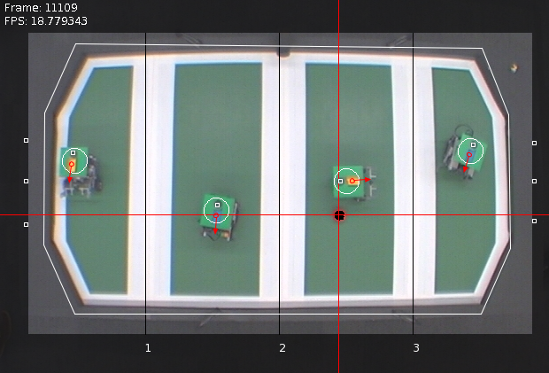
Vision
Streamlined Core Code
Vision Accuracy
User Interface
Notes:
In line with the team ideology, the core vision code is streamlined to work efficiently in this specific environment. By making various assumptions about the pitch setup that we knew to be true, we constructed reliable, maintainable and high performance heuristics for detecting the robots and the ball. The overall idea is to split the task into the four sections of the pitch, at which point you only need to find one robot four times rather than four robots at once. Finding the green plate and then using that information to locate the center of the coloured strip and grey dot allowed us to reliably determine the position and orientation of the robot, at up to 20 frames per second.

Slide 10
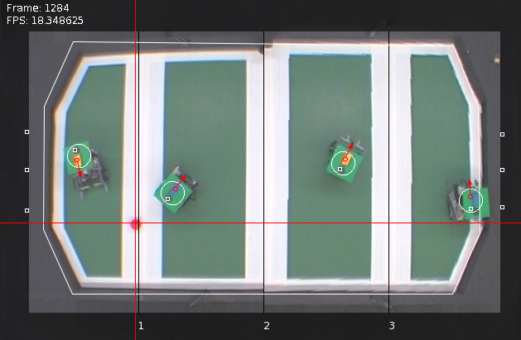
Vision
Streamlined Core Code
Vision Accuracy
User Interface
Before
After
Notes:
Once we had the core code tested, we looked to extend and improve upon it. Through testing it had become clear that catching the ball when it was close to the edge of the pitch (i.e. far from the center of the camera) was a real problem. We concluded that this was due to various distortions from the camera and pitch positioning that needed to be corrected. As you can see in this comparison image, with the three distortion fixes applied the video feed appears much more flat meaning improved catching accuracy across the whole playing area.

Slide 11
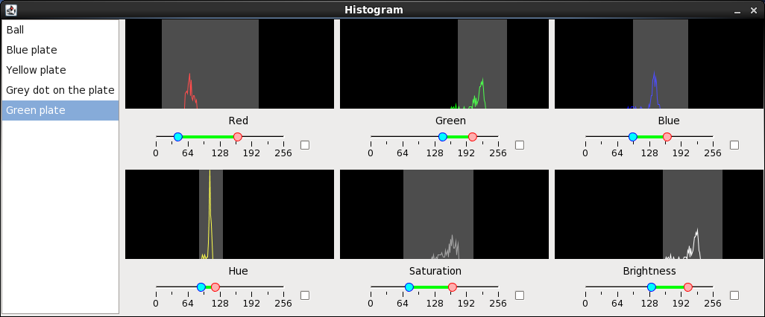
Vision
Streamlined Core Code
Vision Accuracy
User Interface
Notes:
Our vision system is very robust due to the accuracy with which we can select the different colour ranges from the video feed. The major reason for this accuracy is the Histogram Tool in our user interface. This allows us to select a section of the image that contains the object we are looking for and accurately modify the various thresholds before saving them to a file for use in the object recognizer systems.

Slide 12
Robot Design
Daniel Jones
Notes:
Now I will had over to Daniel who is going to talk about robot design.

Slide 13
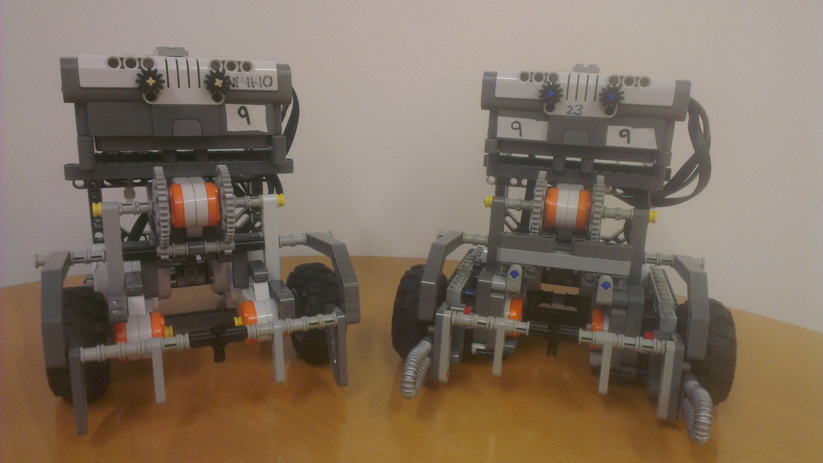
Meet the Robots
Notes:
Beginning of course, hardware, bottleneck, development process
Designing day 1, committing early
Here we have our robots, on the left we have our attacker, and on the right we have our defender.
From the beginning of the course, we knew that hardware could become the bottleneck of our development process if it was not handled correctly. As such, we started designing on day one, with the aim of commiting to a design early.

Slide 14
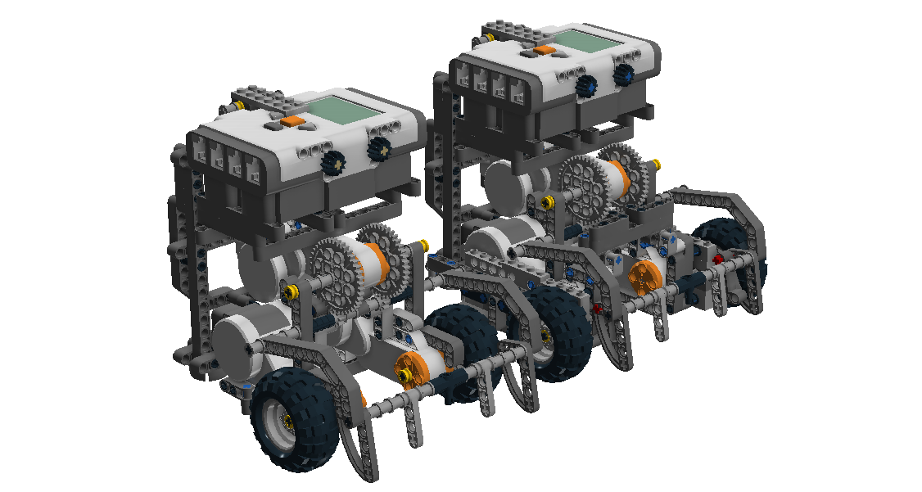
Designing and Testing
Design a lot
Test even more!
Hardware Tests
On Pitch Testing
Two-Way Communication
Notes:
LDD
Design w/o needing use, risking, existing
Existing test new code
Design critical bad time
Sharing
Point: Design
By using the Lego Digital Designer software, we could build new designs without needing the use of, or risking an existing robot. This meant that new designs could be created while the robots were being used to test existing code, or at criticial times when re-building the robot would have been a bad idea. This was used to share designs with the team before any building work began, so we only built what was wanted by the team.

Slide 15
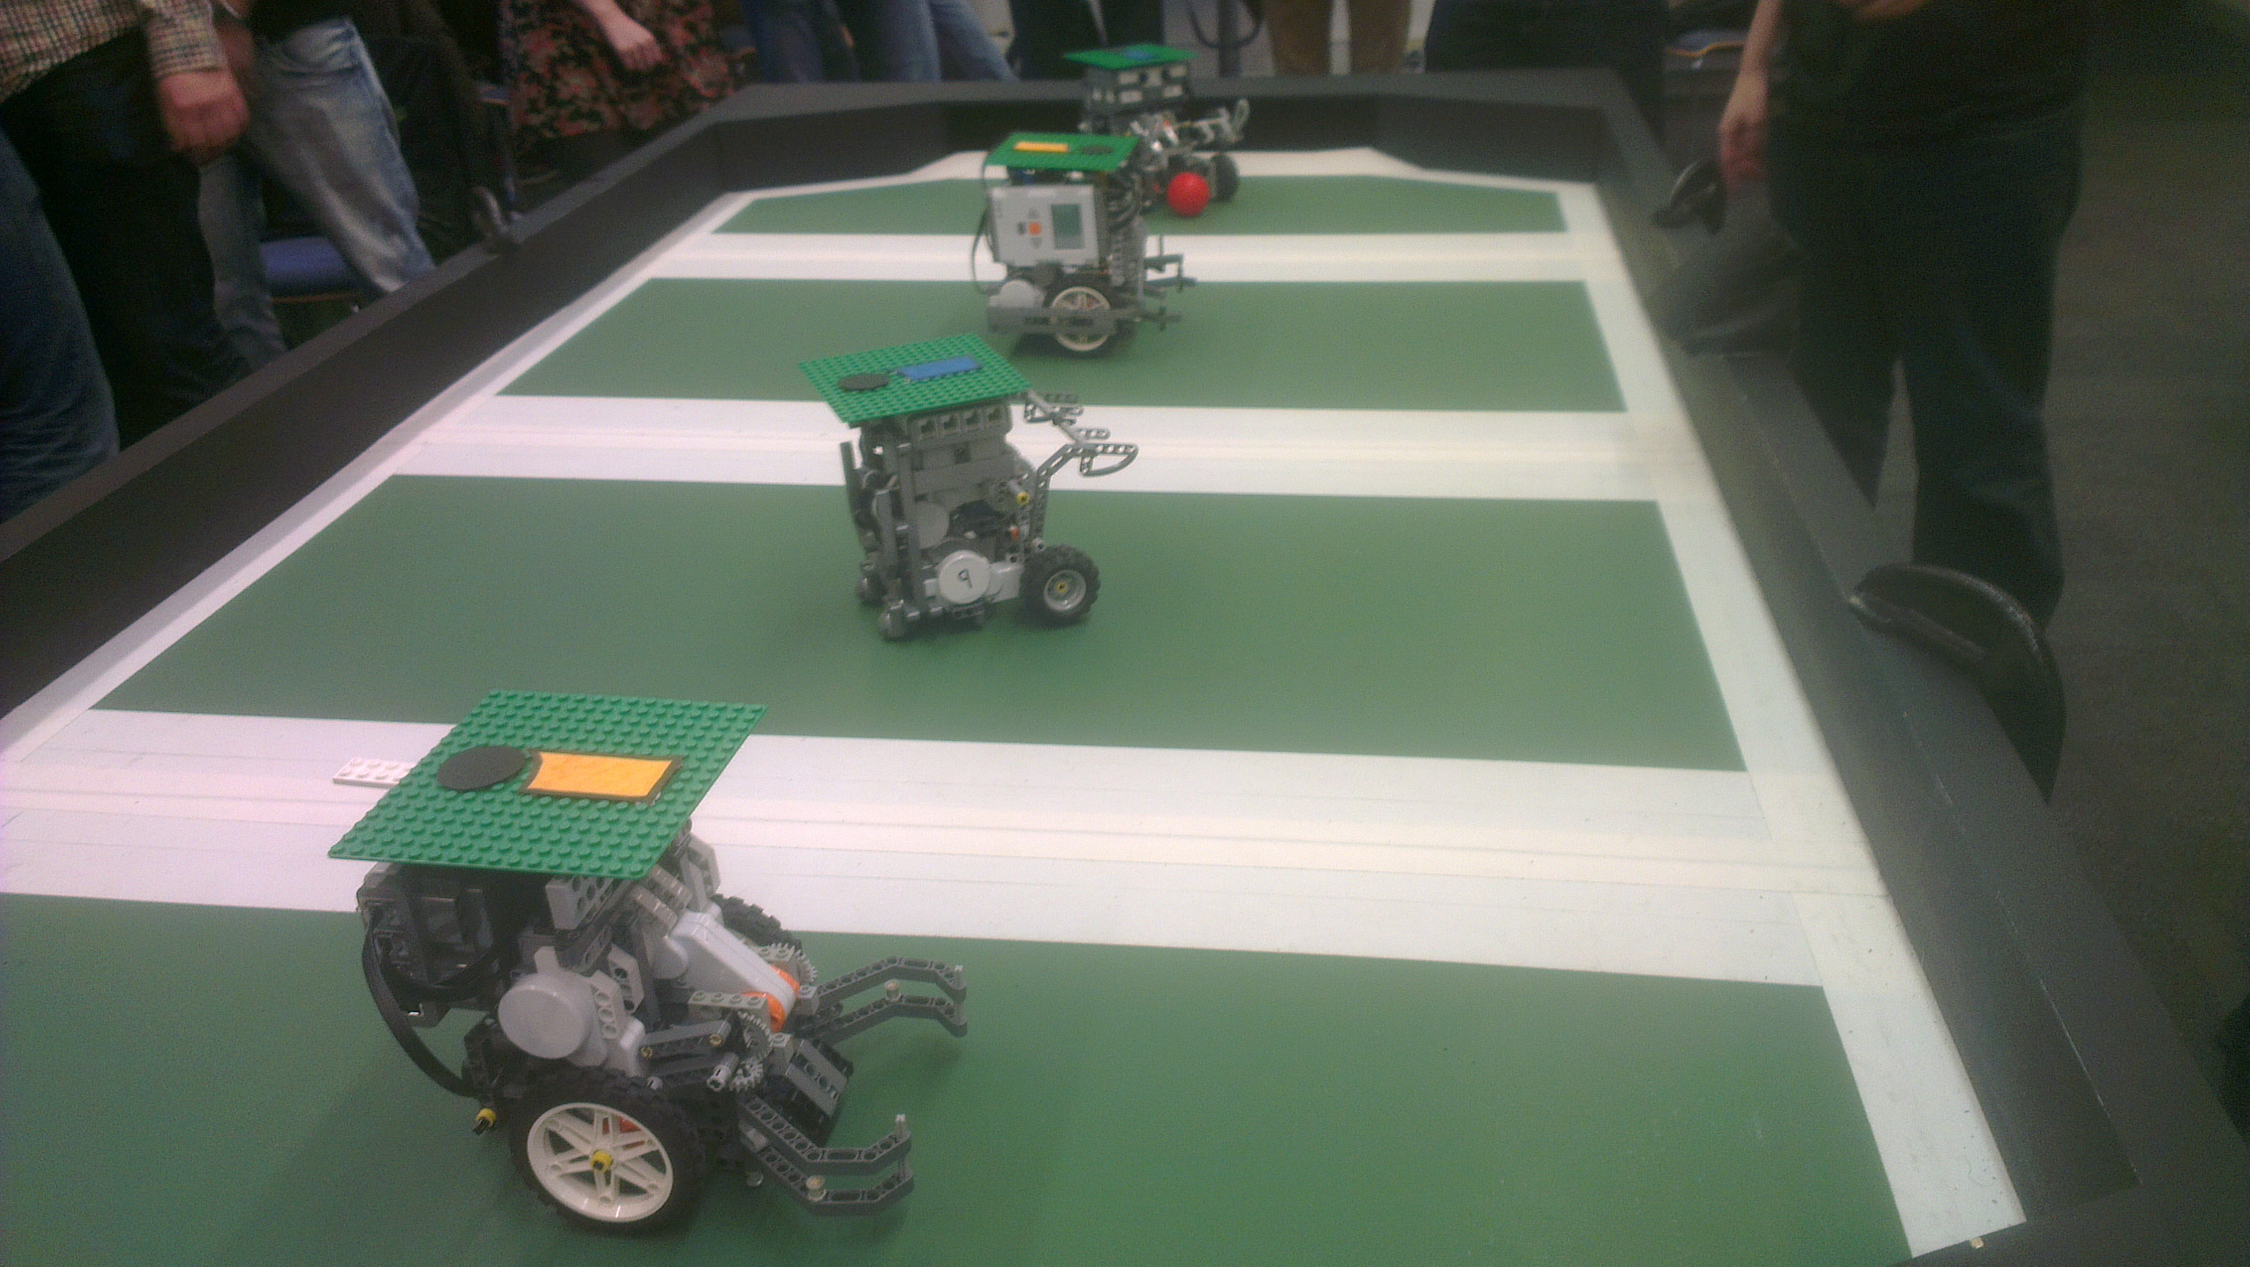
Designing and Testing
Design a lot
Test even more!
Hardware Tests
On Pitch Testing
Two-Way Communication
Notes:
After build, thoroughly test
Hardware specific, evaluate design
On pitch test critical refine
Two way comms essential improving integration
Point: Testing
Once a new design was created, it would be thoroughly tested. Hardware-specific test functions were written to evaluate new hardware, before it would be tested with the vision and strategy code.
On pitch testing was critical to refining the design, with two way feedback between the hardware and software teams critical to improving the integration of any new builds.

Slide 16
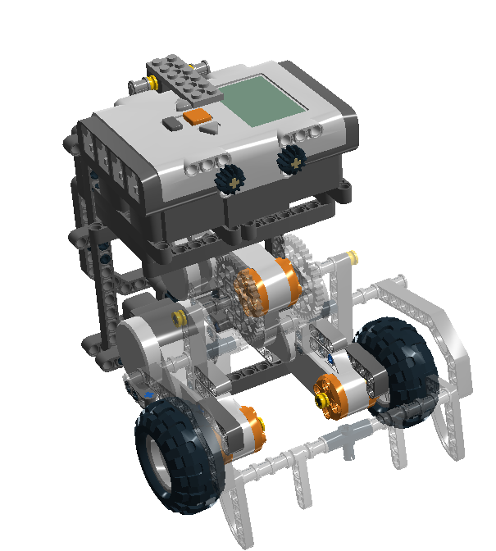
The Chassis
Early Commitment to a Design
Chassis Construction
Robot Differences
Notes:
Decided, Frozen, Early, 2 months
Point: Early Commitment
Here is the chassis of our robot, this was decided on, and frozen, early in the development process, with the current chassis dating back over two months, and we have used it on both of our robots

Slide 17
The Chassis
Early Commitment to a Design
Chassis Construction
Robot Differences
Notes:
Came construction, previous attempts, space catcher, powerful kicker
Raised brick, motor
Ball bearings, space, reliable, team 3
Point: Chassis Construction
We came to this design after we realised that our previous efforts never really left enough room for a high powered kicker or catching device. We created this space by raising the NXT brick and the kicker motor up. We also used ball bearings at the rear instead of castor wheels, which we found were much more reliable and they took up less space. We should thank team 3 for giving us a set to test with which helped in our decision making.

Slide 18
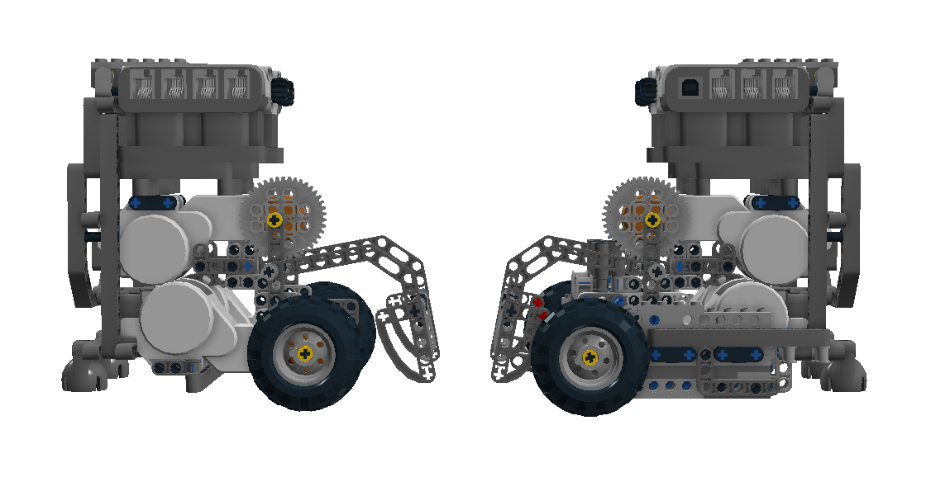
The Chassis
Early Commitment to a Design
Chassis Construction
Robot Differences
Notes:
Biggest Differences, frame
Main FEEDBACK defender slow, intercept.
Gear, build frame, retain structural integrity
Point: Robot Differences One of the biggest differences that you’re likely to spot on our robots today is the frame built around the defender. One of the main points of feedback from the team was that the defender was always a bit too slow to intercept the ball. To alleviate this, we geared the wheels to speed the robot up, which required a frame to be built to retain structural integrity

Slide 19
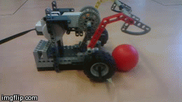
The Catcher
Large Operational Area
Consistent Ball Positioning
Unobstructed Movement
Notes:
Major development, refinement, benefits
Range angles, distances, navigate, position
Intro:
Our catcher was a major development area, and it’s refinement has given us a range of benefits.
Point: Large Operational Area
It reliably catches from a range of distances and angles, this gives us the advantage that we don’t have to navigate our robot to a precise position in order to get the ball.

Slide 20
The Catcher
Large Operational Area
Consistent Ball Positioning
Unobstructed Movement
Notes:
Catch goes center, sides, movement
Stays center, movement unaffected
Point: Ball Positioning
During a catch, the ball moves to the center of the catcher on most occasions, sometimes the ball gets caught at one of the sides, but it always centers after the robot has moved. Once the ball has reached the center, it stays there until the robot kicks.
Point: Unobstructed Movement
and movement is unaffected by us having the ball.

Slide 21
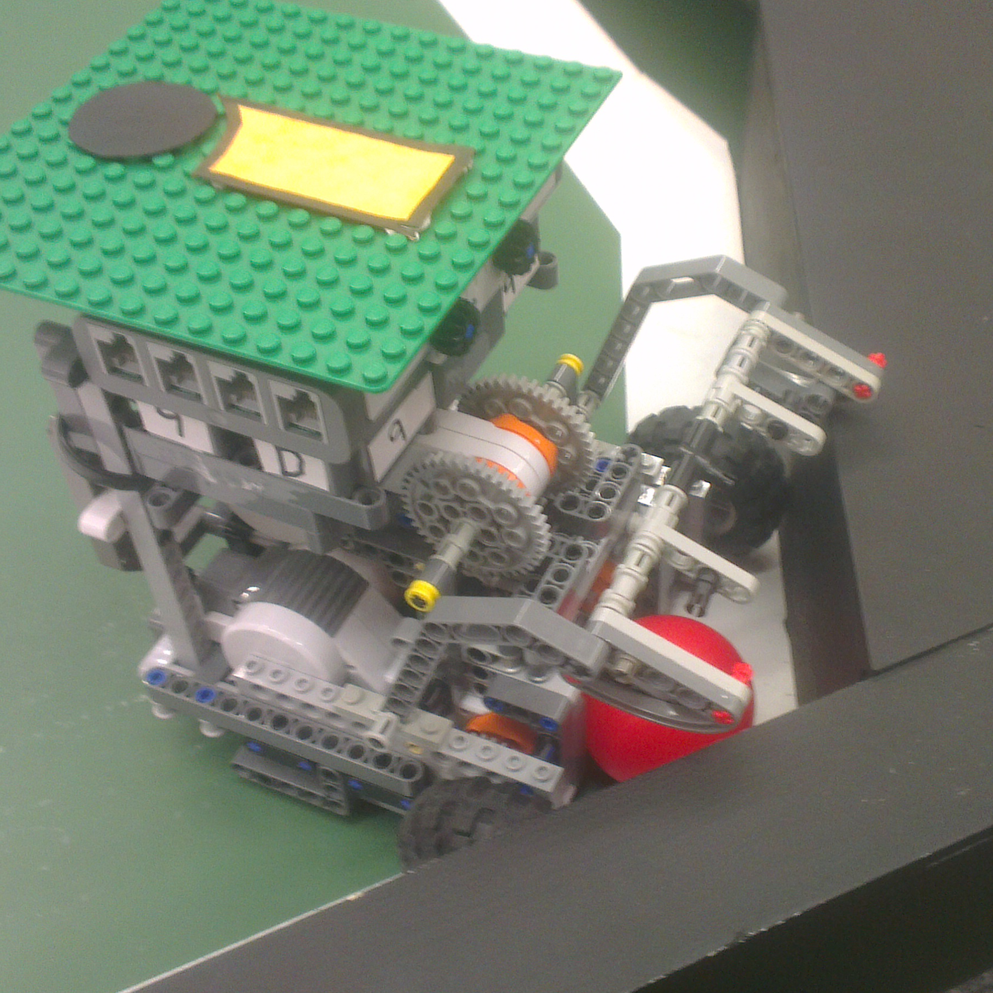
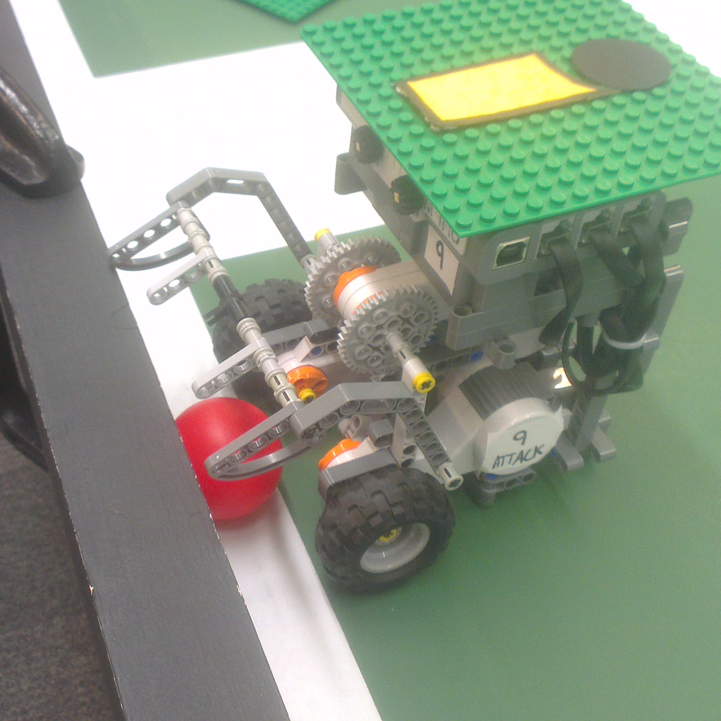
Catching from the Wall
Reliable on Straight Edges
Fails on corners…
Use Attachments
Notes:
Works straight, fails corner tops
Point: Reliable on straight
Our catcher is capable of reliably retrieving the ball from a straight wall, however it gets stuck in the “corners” in the defending zone as we come in over the top

Slide 22
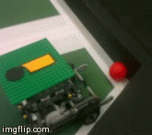
Catching from the Wall
Reliable on Straight Edges
Fails on corners…
Use Attachments
Notes:
Use attach, catcher down, into corner, rotate, knock, get
Point: Attachments
So we developed these attachments, which we can use by driving into the corner with our catcher down, and rotating, which knocks the ball out of the corner, and we can now retrieve it from where it goes.

Slide 23
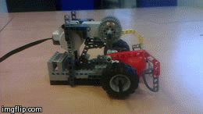
The Kicker
Strong, Accurate, and Reliable
Contact Zone Designed to Prevent Chipping
Part of the Catcher, so a Single Moving Part on a Single Motor
Notes:
When kick, catcher rotate, foot, refined, avoid chipping, kick
High power, accurate
Same place, reliable
Also one moving part, one motor, one code
Point: Strong, Accurate, Reliable
After we catch the ball, when we want to kick, the entire catcher assembly rotates, with a “foot” on the other end to kick the ball, which was carefully refined to avoid chipping the ball. This gives us powerful, accurate shots, and because the ball is kicked from the same place every time our kicks are very reliable.

Slide 24
The Kicker
Strong, Accurate, and Reliable
Contact Zone Designed to Prevent Chipping
Part of the Catcher, so a Single Moving Part on a Single Motor
Notes:
CHANGE SLIDE! ☺
Point: One moving part
And as the kicker is part of the catcher it is one motor, one moving part, one piece of code.

Slide 25
Strategy Subsystem
Asteris Stagkos Bell
Notes:
For coding the robots the Lejos API In Java. All Strategy uses information gained from a world state which is updated by vision, to make decisions.
All strategies are completely deterministic, with nothing left to probabilities.

Slide 26
Strategy Overview
Vision Subsystem
General Strategy
Strategy Selector
World State
Strategy Subsystem
Notes:
General Strategy is a strategy super class that contains methods which are used by many other strategies. such as “TRAVEL TO”, “CATCH BALL”, “RETURN TO ORIGIN”.
Strategy Selector looks at the location of the ball on the pitch and chooses which strategies to run on each robot, accordingly.
Each strategy runs in its own thread, so the strategy selector manages these threads.

Slide 27
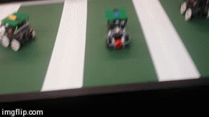
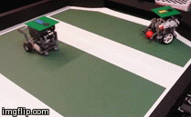
Attacker Robot
Attacking Strategy
Marking Strategy
Passing Strategy
Attacking
Marking
Notes:
Attacking strategy travels to the location of the ball, catches it, moves to a specified position in its zone and shoots towards the goal.
Marking strategy tries to block a pass between the enemy defender and the enemy attacker.
Passing Strategy for the attacker simply makes the attacker face the direction of the pass.

Slide 28
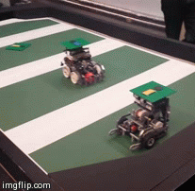
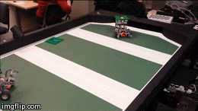
Defender Robot
Defender Strategy
Interceptor Strategy
Passing Strategy
Defending
Passing
Notes:
Defender Strategy uses the enemy attacker’s orientation to defend against a shot.
Interceptor Strategy uses the ball’s travelling direction to block
Passing Strategy catches the ball and passes it to the attacker by bouncing it on one of the two walls.

Slide 29
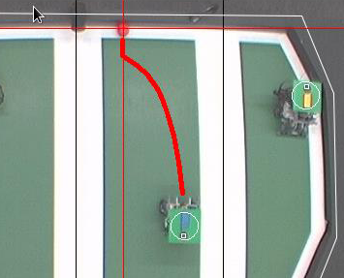
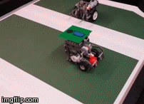
Advanced Strategies
Bounce Shots
Clutch Catching
Smart Reset
Arc Motion
Clutch Catching
Bounce Shot
Notes:
We created a method that calculates a bounce angle for the ball to hit a specified target after being bounced off the top or bottom wall. Our high kicker strength allowed this to work.
Catching the ball from the wall was a challenge addressed by making the robot go to a point perpendicular to the ball and the wall, and then moving slowly and precisely towards the ball in a way that it will always be caught. Added rotation to the end of every catch guarantees the catch to be successful.
Smart reset involves both robots resetting to a safe position if they are ever close to their zone boundaries. Angle testing makes the robots reset in the most efficient way.
Arc movement is used to make our robots rotate towards a target location while moving. It is a much more efficient way of movement that we implemented.

Slide 30
Any Questions?
Thanks for listening!

